Slide 1

IPL ANALYSIS (2020)
done by
RAJAT MONGIA (RA1911031010111)
AAKASH KAUSHIK (RA1911032010001)
Sangireddy Sanjeeva kumar reddy (RA1911003010532)
SAMBUDDHA DAS (RA1911031010109)

Slide 2
Introduction
* The Indian Premier League (IPL) is a professional Twenty20 cricket league in India contested during March or April and May of every year by eight teams representing eight different cities in India.
* The league was founded by the Board of Control for Cricket in India (BCCI) in 2008.
* The IPL has an exclusive window in ICC Future Tours Programme.

Slide 3
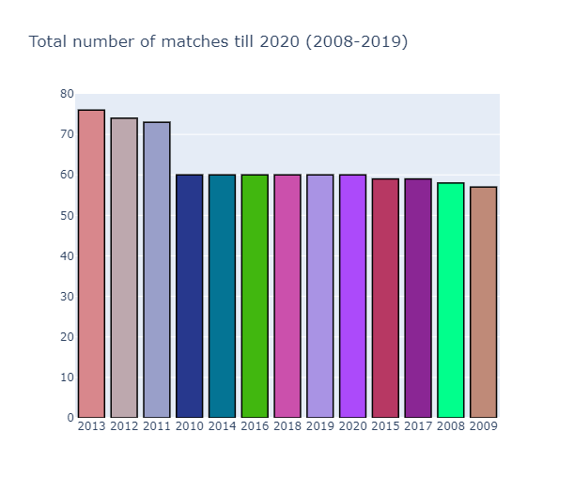
Total number of matches till 2020

Slide 4
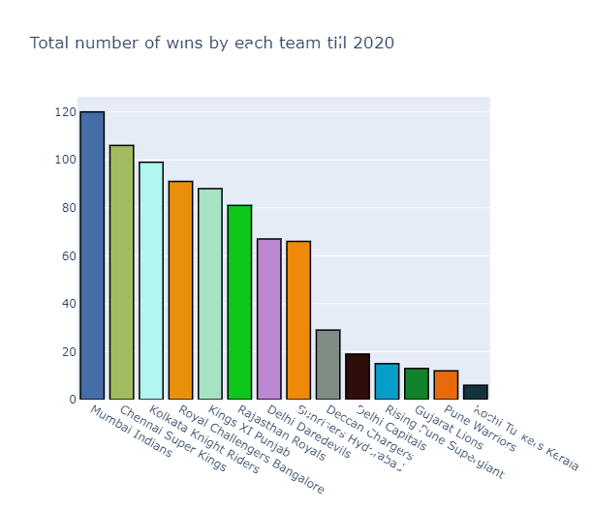
Total number of wins by each team till 2020

Slide 5
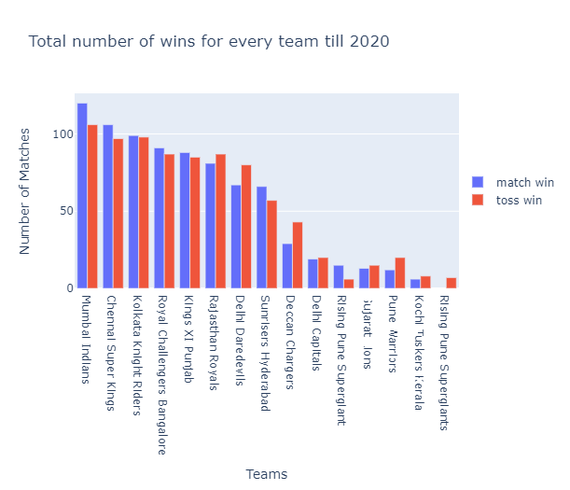
Total number of wins by each team till 2020

Slide 6
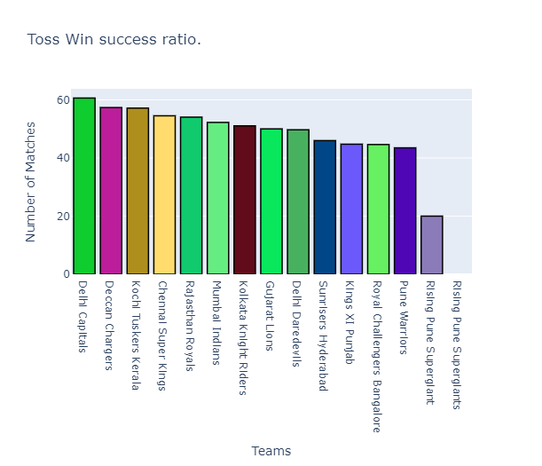
Toss win success ratio

Slide 7
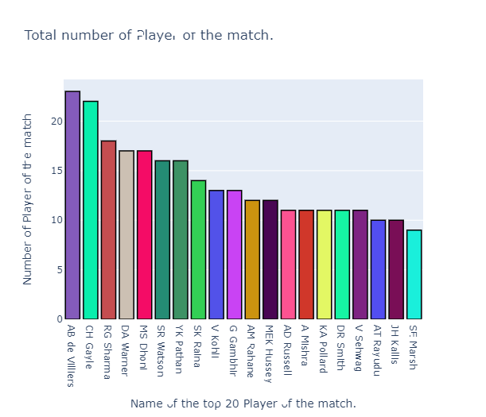
Total number of players of the match

Slide 8
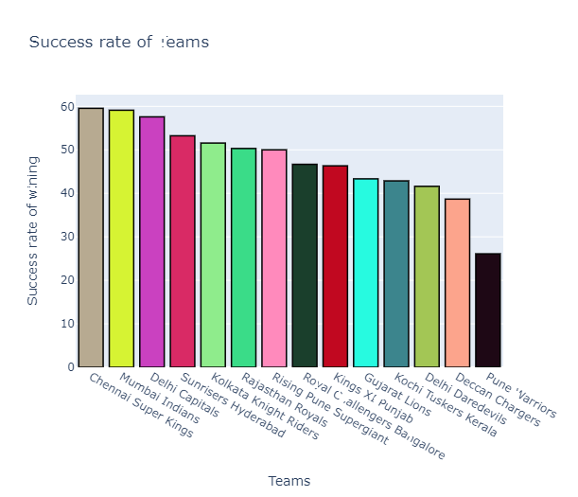
Success rate of Teams

Slide 9
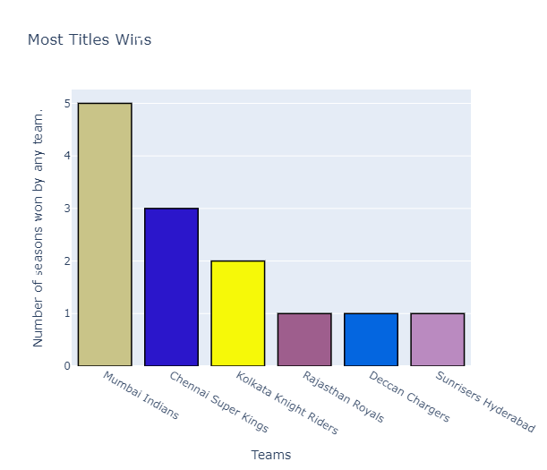
Most titles win

Slide 10
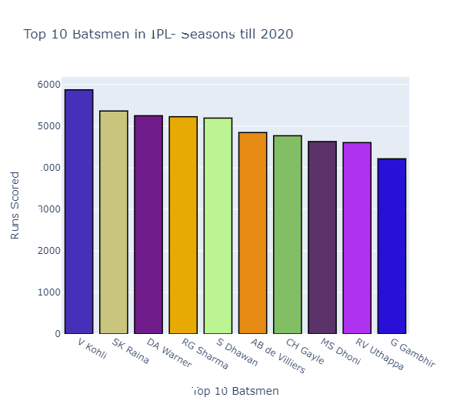
Top 10 Batsmen in IPL Seasons till 2020

Slide 11
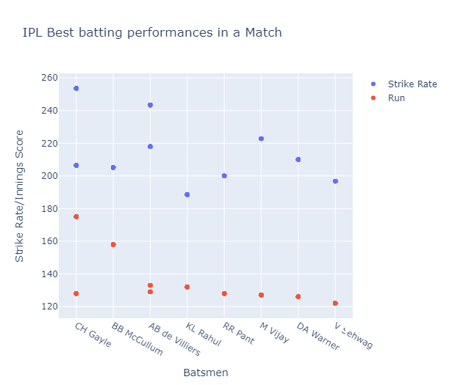
IPL Bating performances in a match

Slide 12
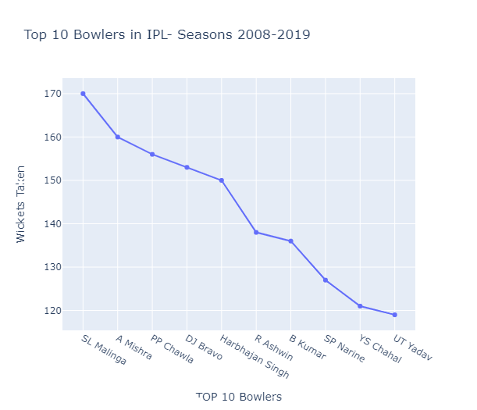
Top 10 bowlers in IPL Seasons 2008-2019

Slide 13
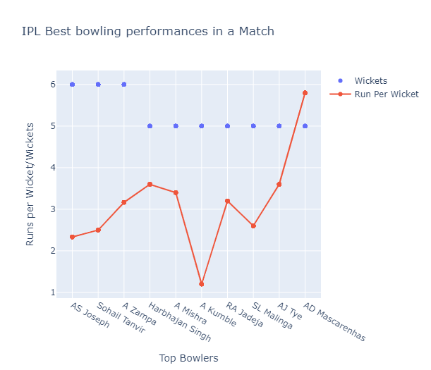
IPL Best bowling performances in a Match

Slide 14
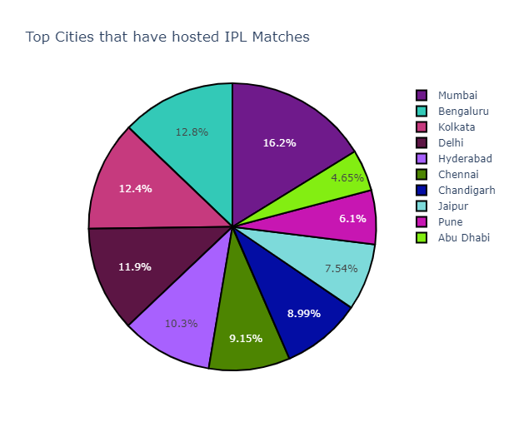
Top cities that have hosted IPL Matches

Slide 15
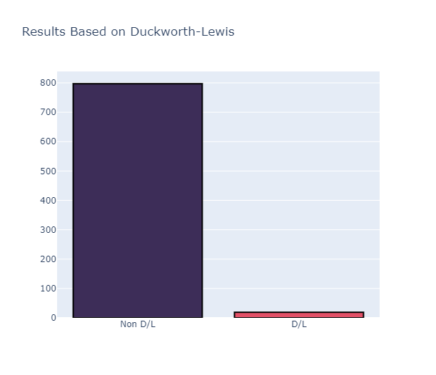
Results Based on Duckworth-Lewis

Slide 16
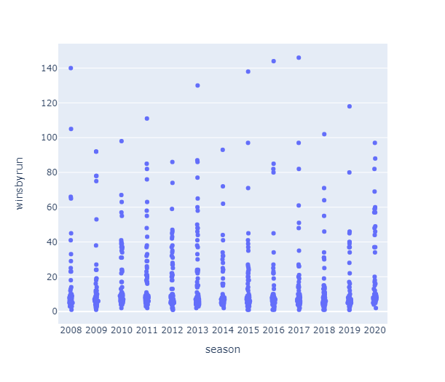
Season wise match summary of matches won by runs

Slide 17
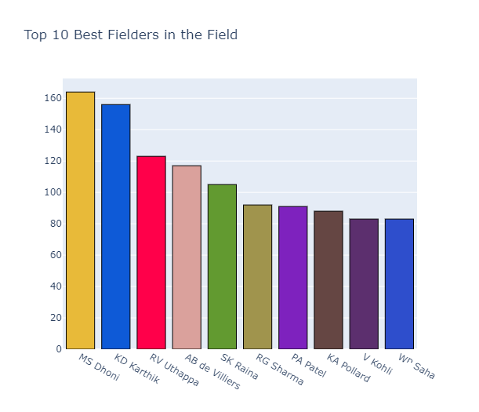
Top 10 Best Fielders in the Field

Slide 18
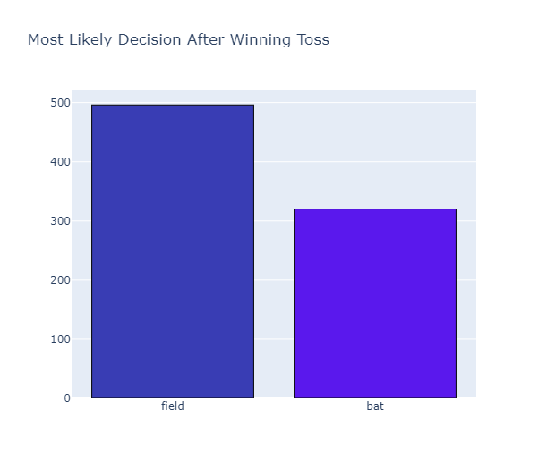
Most Likely Decision After Winning Toss

Slide 19
Libraries used in Projects
-> Numpy
-> Pandas
-> Matplotlib
-> Random
-> Plotly
-> Wordcloud
-> PIL
-> Pywaffle
-> Seaborn

Slide 20
Thank you

